Slide 1
Browser Forensic

Slide 2
Introduction:
The main function of a browser is to present the web resource you choose, by requesting it from the server and displaying it in the browser window.
The location of the resource is specified by the user using a URI (Uniform Resource Identifier).
Browser user interfaces have a lot in common with each other. Among the common user interface elements are:
Address bar for inserting a URI
Back and forward buttons
Bookmarking options
Refresh and stop buttons for refreshing or stopping the loading of current documents
Home button that takes you to your home page

Slide 3
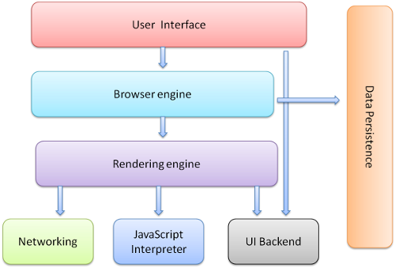
Browser Components
Notes:
https://medium.com/@ramsunvtech/behind-browser-basics-part-1-b733e9f3c0e6

Slide 4
Rendering Engines
Rendering - The Act of Interpreting something as expressed in an artistic performance
Internet Explorer uses Trident, Firefox uses Gecko, Safari uses Web-Kit. Chrome and Opera (from version 15) use Blink, a fork of Web-Kit.
Web-Kit is an open source rendering engine which started as an engine for the Linux platform and was modified by Apple to support Mac and Windows.

Slide 5

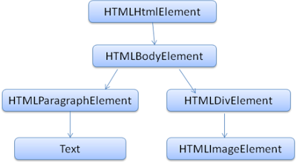
Rendering flow

Slide 6

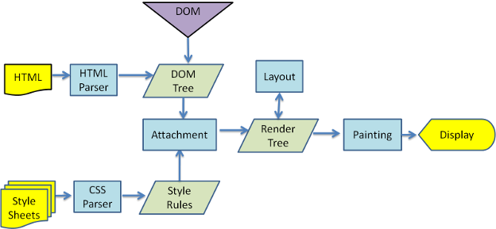
Detail Flow & The HTML DOM Tree of Objects

Slide 7
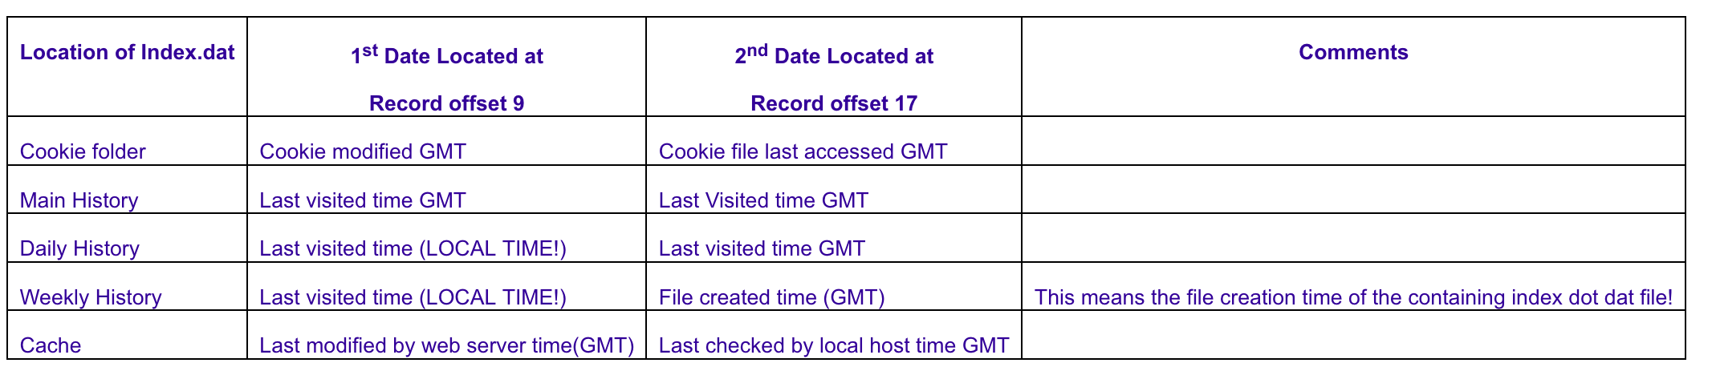
Index.dat and webcache.dat
The "index.dat" file is a database file used to manage, among other things, MSIE browser functions.
There is an "index.dat" in the cookie folder, one in the "history" folder, one in each daily history folder, one in each weekly history folder, and one sitting at the root of the Content.IE5 folder under Temporary Internet Files (Cache Folder).
Notes:
https://kb.digital-detective.net/display/BF/Document+Object+Model+Web+Storage
https://kb.digital-detective.net/display/BF/Internet+Explorer+Cache

Slide 8
Sourc
Cookie Index.dat Starting at byte offset 105: Cookie:[username]@[website URL].Ends in hex 00 History File Starting at byte offset 105: [username]@[website URL]. Ends inhex 00 Daily History Index.dat Starting at byte offset 105: :[date range]:[username]@[website URL]. Ends in hex 00 (if date range coversa day, it's a daily history) Weekly History Index.date Starting at byte offset 105: :[date range]:[username]@[website URL]. Ends in hex 00 (if date range coversa week, it's a weekly history) Cache Index.dat Starting at byte offset 105: URL. Ends in hex 00

Slide 9
Browser Artifacts
The signature appears to be highly predictable (at least based upon my limited research) and presents as follows:
Lead-in (hex): 61 80 00 00 00 00
URL (variable length)
If there is a title present:
10bytes (doesn’t appear to be consistent, however sometimes 0x2A or 0x40appears in the 7th byte – I’m sure these have some significance, I justhaven’t figured out what yet)
Website title (variable length)
Lead-out(hex): 01 00 + 6 bytes of null padding + FF FF FF FF (may notconsistently appear, and doesn’t appear to be used if a title is notpresent)
Notes:
https://dereknewton.com/2011/01/internet-explorer-inprivate-browsing-url-artifacts/

